Slide 1



Information Systems and Database Management
Group project
21/22
Alessandro Pretolani
Gabriele Fanciulli
Luca Sabbatini

Slide 2




Table of Contents
Dataset
File Administration
Variables Explanation
Importing Data
Tables
Creation
Entity Relationship Diagram
Queries

Slide 3




FILE ADMINISTRATION
Choice of the Dataset
Excel data clean up & manipulation
Dataset Segmentation
Find & Replace

Slide 4
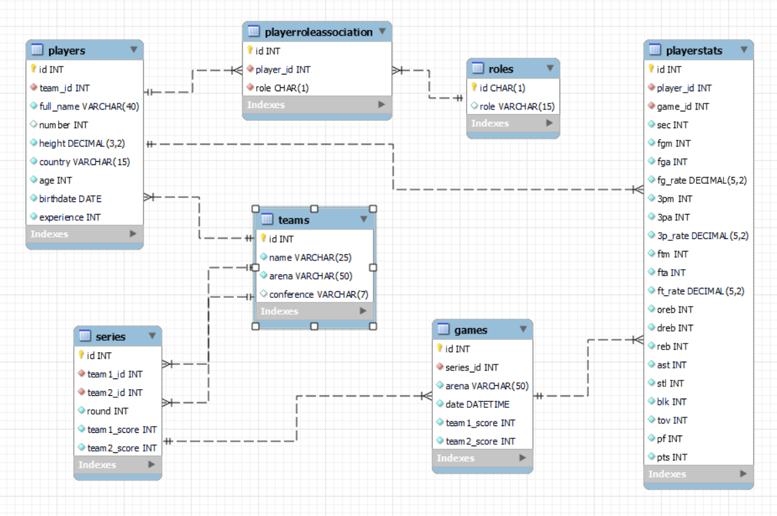
Tables Preparation

Slide 5
ER Diagram
PARENT TABLE

Slide 6

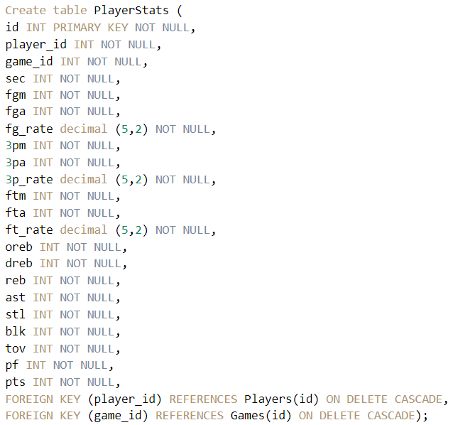

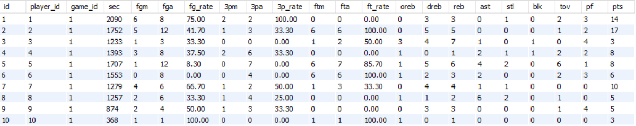
Players Stats
Table
Compound Foreign Key

Slide 7

Stats for an NBA Player
FGM
Field Goals Made
FT_R
Free Throws Made
Field Goals Attempted
FGA
Offensive Rebounds
OREB
FG_R
Field Goal %
DREB
Defensive Rebounds
3 Points Attempted
3PA
AST
Assists
3PM
3 Points Made
STL
Steals
3 Points %
3P_R
Bloks
BLK
FTM
Free Throws Made
TOV
Turnovers
Free Throws Attempted
FTA
Personal Fouls
PF

Slide 8
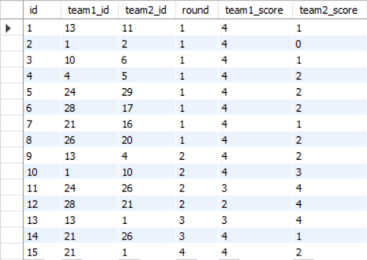
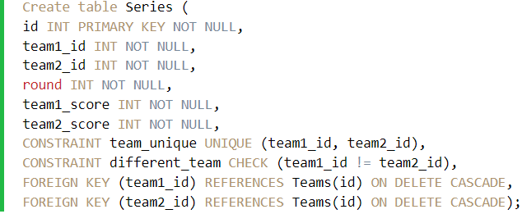

Series
Table
Compound Foreign Key

Slide 9

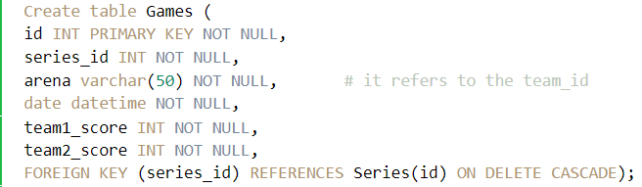
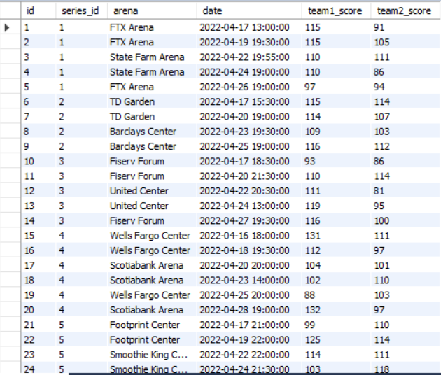
Games
table

Slide 10
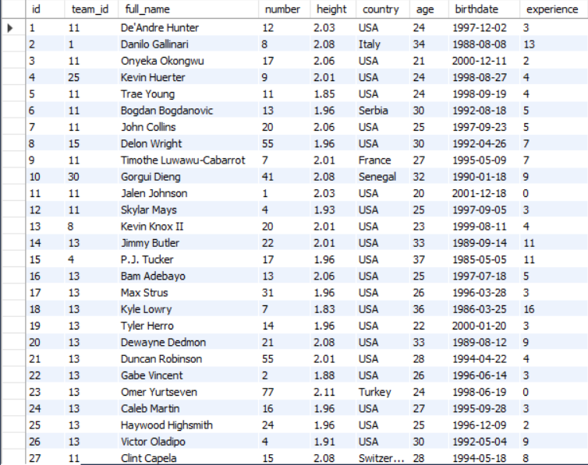
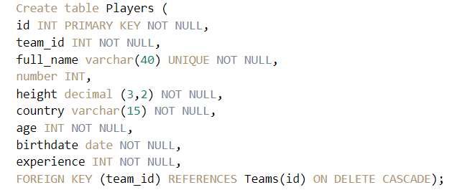


Players table

Slide 11

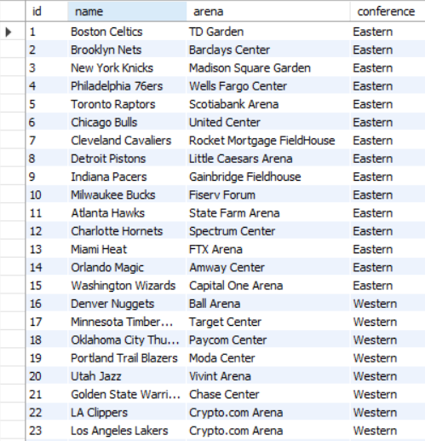


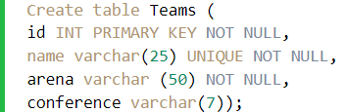
Teams table

Slide 12


Importing the data

Slide 13
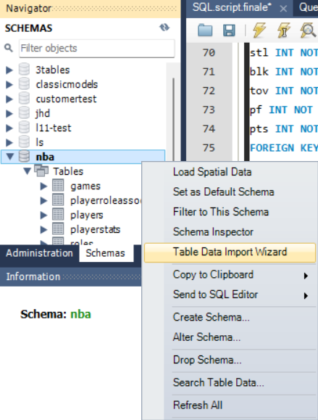


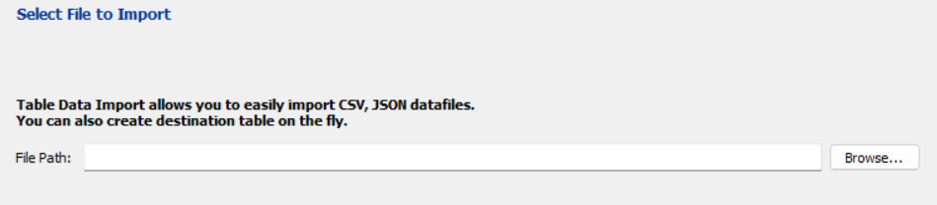
Wizard import
from excel
Browse to file location

Slide 14
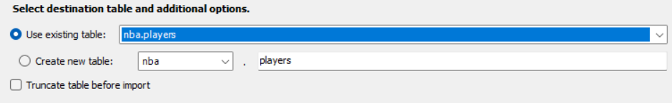
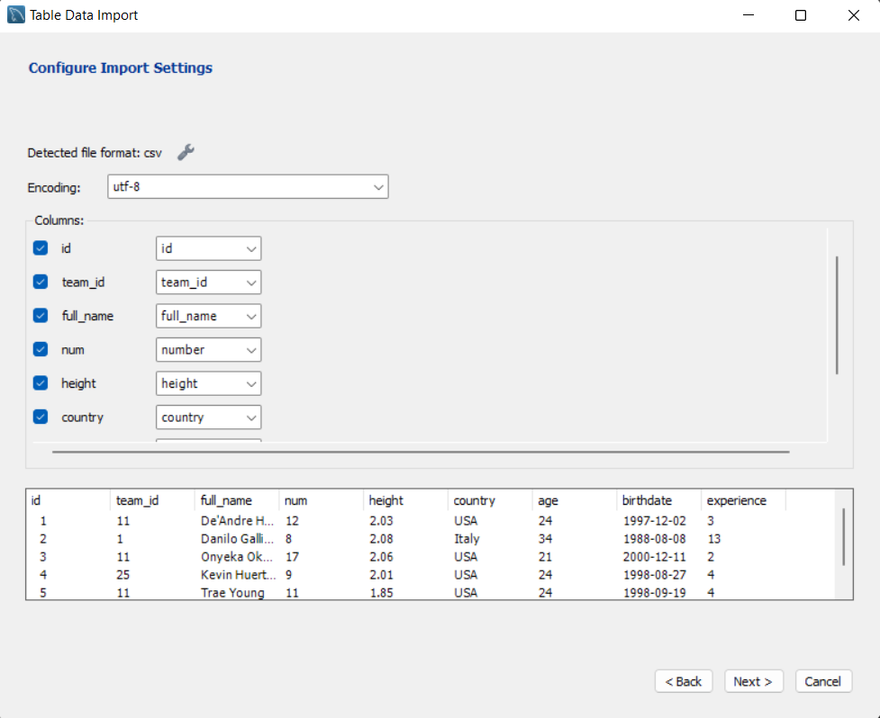
Using the table we previously created
Creating the tables we made sure to get a match with the csv columns.

Slide 15

Thanks
for the
attention

